Slide 1
IoT Standards and Protocols
Frank Walsh

Slide 2
Agenda
IoT Characteristics
1
IoT challenges
2
IoT Protocol Stack?
3
Plan for the Future…
4
What you need to know.
5

Slide 3
Characteristics
Everyday objects with embedded technology to sense, connect, and communicate.
Empowered by:
Sensors, cheap and accessible compute power (microcontrollers), ubiquitous connectivity, networking and internet protocols.
Transforms isolated, passive things to connected things with compute power.
Collaborate to enable ground breaking applications.

Slide 4
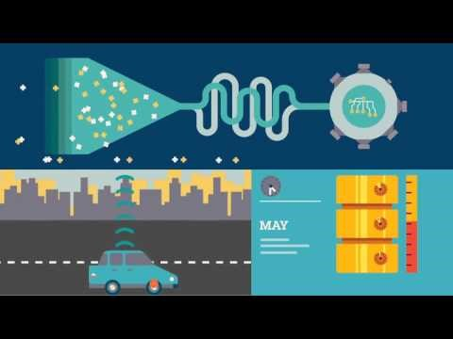
More Characteristics

Slide 5
Fundamental parts for IoT
Devices
Send and Receive data
Network
Data is transmitted, routed
Edge Computing
Data is normalised, filtered,
Storage
Databases and data stores
Applications
Process and use data
People
Act and collaborate

Slide 6
IoT Reference Model

Slide 7
IoT Reference Model
IT/OT convergence is the integration of information technology (IT) systems used for data-centric computing with operational technology (OT) systems used to monitor events, processes and devices

Slide 8
IT/OT Integration
“IT/OT integration is the end state sought by organizations (most commonly, asset-intensive organizations) where instead of a separation of IT and OT as technology areas with different areas of authority and responsibility, there is integrated process and information flow.” – Gartner

Slide 9
How to link IT and OT
Edge computing “layer”:
Device Control
Configure & Status
Device Interactions
Discovery, addressing, Protocol Conversion
Middleware
MQTT, Zigbee
Data manipulation
Normalise, Filter, Aggregate, Notify
Combining the above allows for interaction with devices

Slide 10
IoT Issues
OT Layer
Lots of “Data in Motion”
Sensors constantly producing data.
IT Layer
Lots of “Data at Rest”
Apps tend to query data in databases and data stores
Devices (OT) can generate data faster than apps(IT) can consume it.

Slide 11
IoT Issues
Need to decouple the IT layers (Applications etc.) from OT layers (devices and sensors)
Need protocols and standards that allow for scalable, interoperable integration between the IT and OT world
That’s why we need Open, Accepted Standards and Protocols for IoT application.
Enable middleware, edgeware, applications and devices from different vendors to interact.
We need IoT Standards and Protocols.

Slide 12
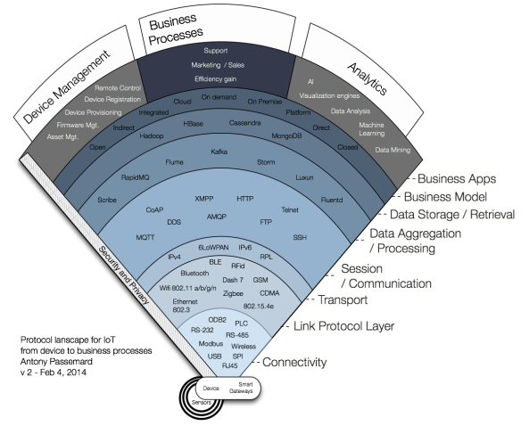
IoT Protocol Stack?
many protocols, many standards. Starting to consolidate
Some strong standards starting to emerge that address the IT/OT link
We will try to look a protocol in each layer, building a reference app that combines several.

Slide 13
IoT Stack Protocols.
Connectivity layer: The Actual physical connectors. RJ45 (usually for Ethernet), RS-232, ModBus, USB (as a connector type, not the communication protocol), SPI, ODB2 (in Cars), and Wireless (no connector!). Gateways can convert physical connectors into wireless.
Link Protocol: How do those device actually send the data. Ethernet 802.3, Wifi 802.11a/b/g/n, BlueTooth, BLE, ZigBee, Rfid, 6LoWPAN, 802.14.5e, CAN, SigFox, LoRa
Transport: IPv4 and IPv6
Session / Communication: MQTT, a subscribe and publish protocol that is used by Facebook for its mobile app, XMPP and AMQP , FTP, Telnet and SSH,
Data Aggregation / Processing: When device send data, lots of data, you need an end point to do something with it. Storm, RapidMQ, Scribe
Data Storage / Retrieval: The realm of Big Data backend and NoSQL solutions. Hadoop, HBase, MongoDB and Cassandra dominate the field.

Slide 14
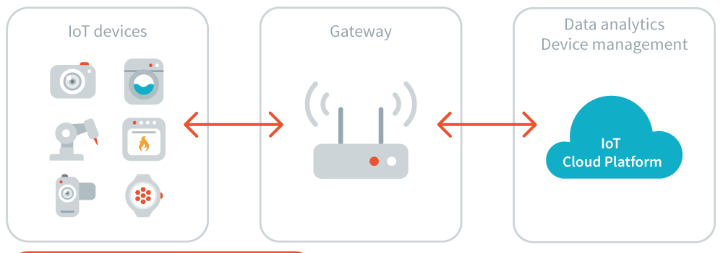
Plan for the Future…
Idea is to realise a prototypical full stack IoT solution which uses open standards and protocols to integrates IT and OT.
Project style approach
Have a working artefact that demonstrates skills from other modules on the course.
Use things
Raspberry pi, Arduino, SiPi…
Use languages
Java, Python, scripting
Use cloud platforms
Amazon AWS IoT, Thingspeak

